Slide 1
Mitigation through enhancement of forest carbon stocks – How far are countries willing to go?
Notes:
This presentation builds on work we did for UNEP’s 2015 EGR….
Forest chapter – examined global potential for forest-related mitigation
and national statements on their willingness to undertake forest-related mitigation.

Slide 2
Forest restoration as a REDD+ activity
Notes:
There is particular interest in the role of restoration in REDD+ as it’s a key topic under UNFCCC.
The 5 REDD+ activities
Restoration activities contribute primarily to Enhancement of forest carbon stocks

Slide 3
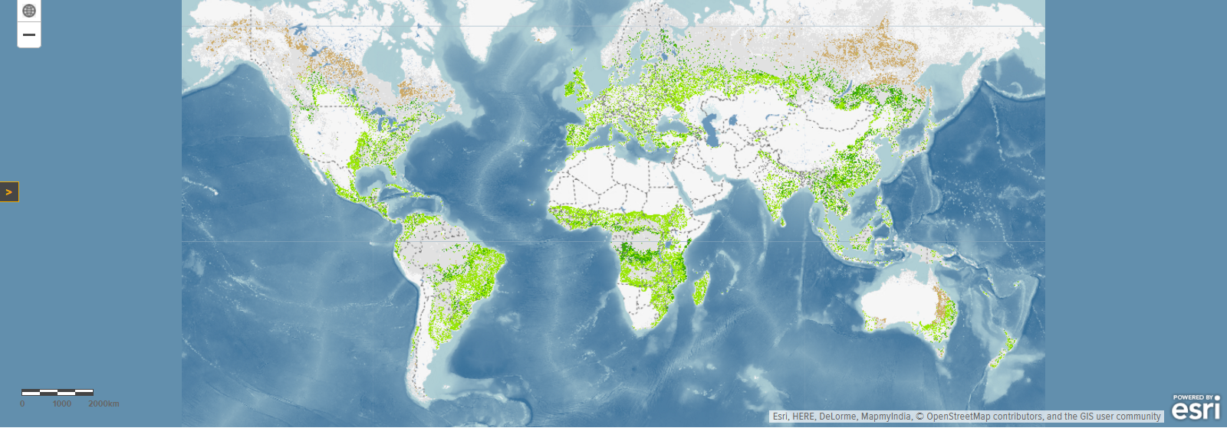
Potential for wide-scale forest restoration (dark green)
From Atlas of Forest Restoration Opportunities (WRI / Univ. Maryland / IUCN)
Notes:
Many of you will already have seen the map of Forest Restoration Opportunities produced by WRI and partners.
The main types of restoration opportunity shown are ‘wide-scale’ – restoring wall-to-wall trees – dark green
‘mosaic’ – adding more trees to a mixed landscape – pale green
(& ‘remote’ – opportunity where there is very low population density - brown)
We wanted to estimate the global technical potential for climate mitigation through forest restoration. By technical I mean the potential before economic considerations are taken into account.Difficult to estimate this in mosaic restoration areas as % of additional tree cover will depend so much on local needs and objectives.
So for this analysis we focused on the area of wide-scale restoration, taking this as a conservative estimate of the technical potential.
Shown on the map as dark green- you can see there’s about 3x as much mosaic restoration potential on top of this

Slide 4
Estimating mitigation potential from forest restoration in developing countries
Restoration potential about 3.8 GtCO2 per year.
Estimated using
Widescale restoration potential map
Ecological zones (FAO 2012)
Above & below-ground biomass growth for natural forest in each ecological zone (IPCC 2006)
Notes:
We took that map of widescale restoration potential and used IPCC figures on biomass growth in natural forest for different ecozones to estimate what the annual mitigation potential might be, IN DEVELOPING countries. Used non-A1 as an approximation.
Got to an estimate of about 3.8 GtCO2 per year – in chart compare it halting the emissions from tropical deforestation are about 3.4 GtCO2 per year
Deforestation emissions Cf = means from Achard (2000-2010) and Harris (2000-2005) studies. So that’s very substantial.
area of widescale restoration potential WRI (2011) in different FAO ecological zones FAO (2012) for non-Annex I countries in UNEP region codes (excluding Europe and West Asia), multiplied by net annual CO2 uptake based on IPCC (2006) [annual net above + below-ground biomass growth, for natural forest in each ecological zone]/ [biomass to carbon conversion factor = 0.47] * [carbon to CO2 conversion factor = 3.67].

Slide 5
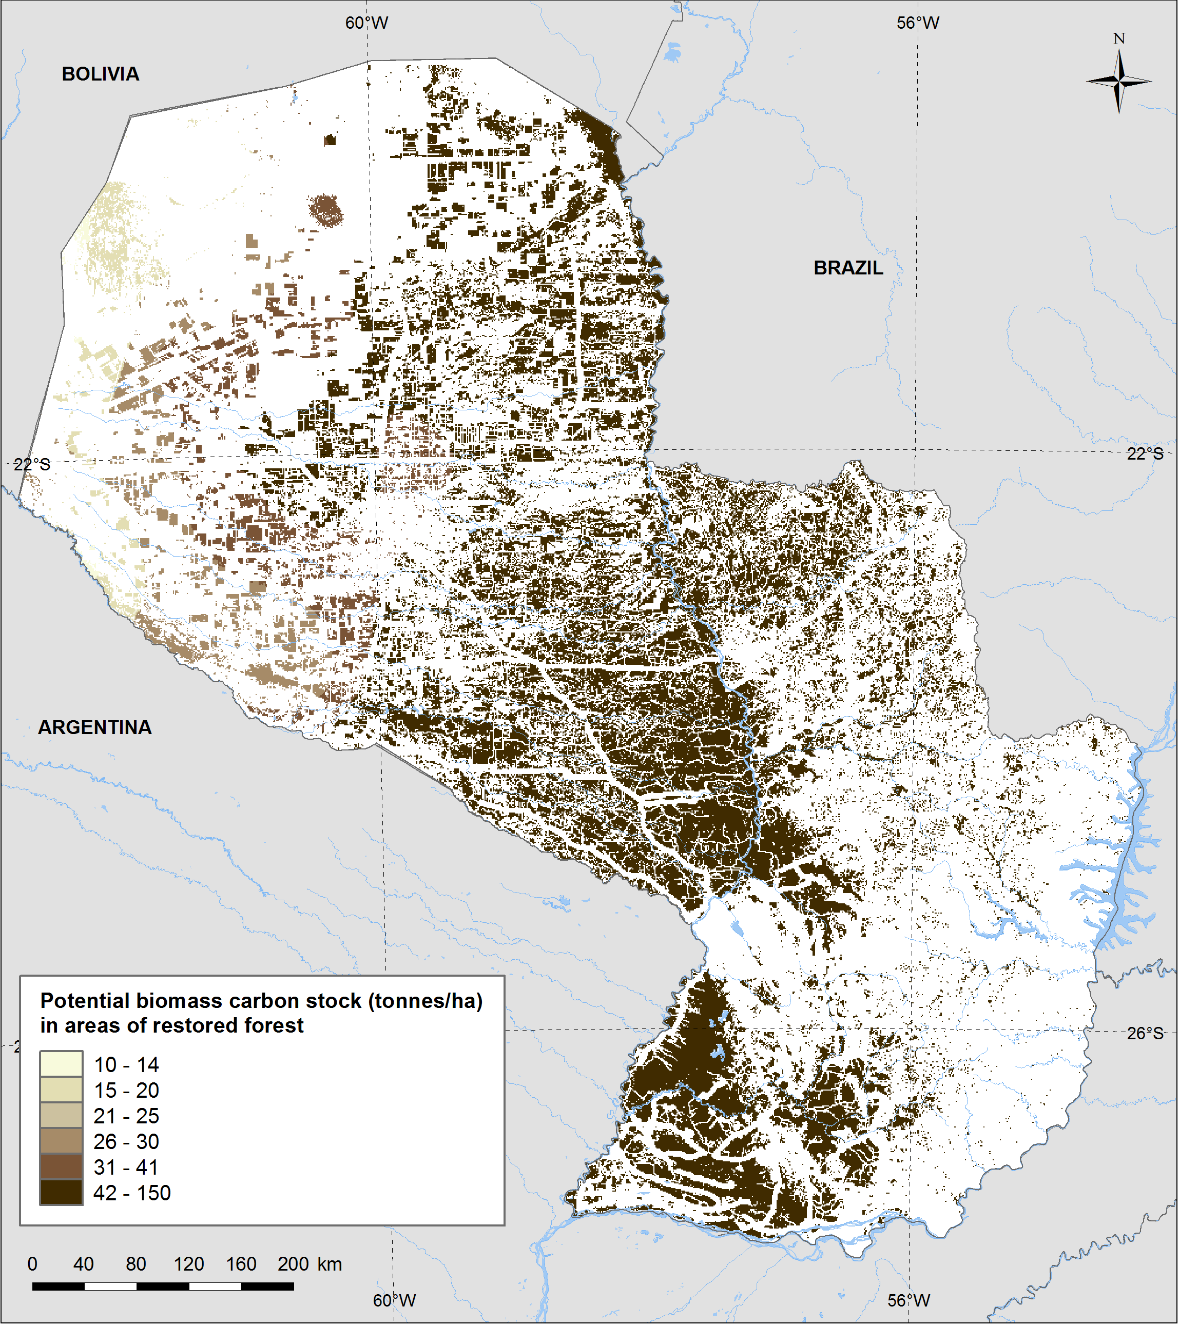
Paraguay - potential biomass carbon stock in areas with forest restoration opportunities
National analysis required to fine tune by country
Potential increased terrestrial biomass carbon
National model of opportunity (UN-REDD) * global biophysical model of carbon potential (Smith et al. 2013)
Notes:
Now, that’s just based on a global analysis. To understand what the potential in any given country might be, need a more detailed analysis (such as ROAM).
This example for Paraguay shows potential increased biomass carbon in areas where forest could be restored. You can see from the map that the criteria here included distance from roads.
In this case a process-based model (Smith et al. 2013) used to assess potential carbon stocks held in undisturbed vegetation - predict carbon flows between leaves, stems, roots and soil pools - with about 70% accuracy when assessed at global scales (Smith et al. 2013)

Slide 6
National statements on forest-related mitigation
Intended Nationally Determined Contributions (INDCs).
Nationally Appropriate Mitigation Actions (NAMAs).
Bilateral arrangements for REDD+
Carbon Fund proposals
Bonn Challenge and Initiative 20x20 commitments on forest landscape restoration (IUCN, no date)
The New York Declaration on Forests (national signatories)
Notes:
What are countries goals in this context? We reviewed a range of statements that could shed some light on this.
Donors (including Norway and Germany) have agreements with Brazil, Ethiopia, Guyana, Indonesia, Liberia, Ecuador, and Peru to provide funding conditional upon demonstrated success in contributing to mitigation through REDD+ (‘results-based payments’). Other donors have made or are negotiating similar bilateral agreements.
; as documented in ER-PINs (FCPF, no date)

Slide 7
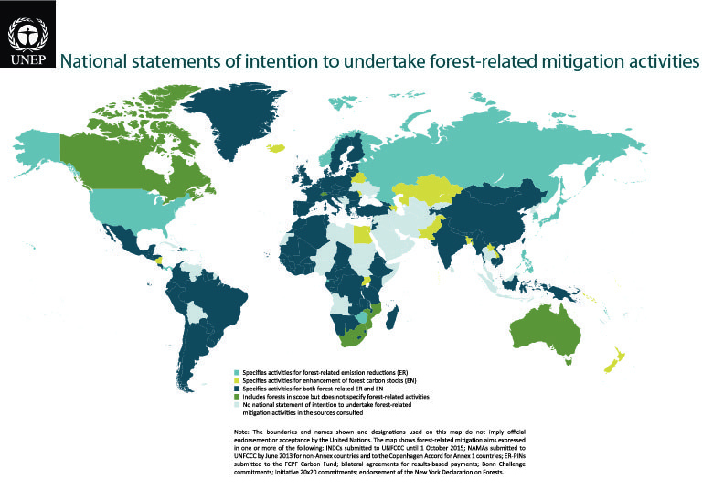
National statements on forest-related mitigation
Map – with flash-up of range of statements consulted
Notes:
Here for all countries see forest-related mitigation statements
Map from EGR
Yellow- countries said intend to do enhancement
Dark blue – both enhancement and reduced emissions
Khaki green – forests but not specifying activities
All in all 83 non-Annex I countries have said that they are aiming to enhance forest carbon stocks

Slide 8
National statements on restoration area compared to wide-scale restoration potential
Notes:
We were interested in looking at this in relation to REDD+, so focused on developing countries, though not all these statements explicitly reference REDD+.
36 developing countries gave an area goal for enhancing forest carbon stocks → 141 million hectares (when take biggest per country)
Another 47 countries intended to enhance carbon stocks but did not suggest an area
Here showing Million hectares by region in countries’ statements compared with widescale restoration potential
Noting this comparison is with the widescale numbers… the mosaic restoration numbers are another 1.5 billion hectares globally, with a global potential of 0.5 billion. Here we are looking at developing country total of about 0.35 billion (351 million) hectares of widescale (no comparison with global)
Reference the additional Bonn challenge

Slide 9
Mitigation potential based on this area?
Regional summary of national statements (area)
Regional estimate of widescale mitigation potential (GtCO2 and area)
Max is overestimate for the 36 countries
Very, very approximate
range
??? to 1.48 GtCO2 per year
But 47 countries not included
Notes:
Have estimates for regional widescale restoration potential
& national statements on all types of enhancement of forest carbon stocks
Very, very roughly this could deliver a MAXIMUM mitigation potential of 1.5 GtCO2 per year [a lot!]
… but assumes all implemented as widescale restoration, which is unlikely.
To identify actual potential, need national scale analysis and planning

Slide 10
Conclusions
Across different fora, developing countries stated an intention to restore, afforest or reforest at least 141 million hectares of land.
INDCs often emphasise the need for international financial support to enable forest-related mitigation – conditional commitments
A significant opportunity to help narrow the emissions gap and facilitate the global transition to a low-emission pathway, limiting global average T increase to < 2°C in 2100
National-scale planning will be needed to quantify mitigation contribution from restoration commitments
Coming next: practical example of Brazil’s restoration plans
Notes:
Plug EGR sessions – Friday evening in EU Pavilion

Slide 11
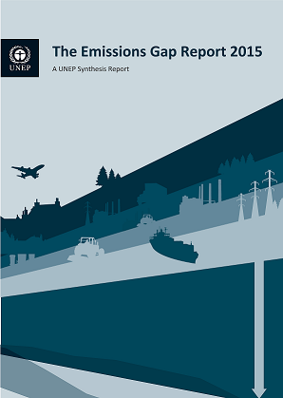
Thank you! See also: Emissions & adaptation report side event EU Pavilion (blue zone) Friday 4 December 18:30-20:00
Notes:
To find out more about the EGR please visit the EU Pavilion in the blue zone on Friday evening

